Slide 1
OCI Load Balancing Service (LBaaS)

Slide 2
Safe Harbor Statement
The following is intended to outline our general product direction. It is intended for information purposes only, and may not be incorporated into any contract. It is not a commitment to deliver any material, code, or functionality, and should not be relied upon in making purchasing decisions. The development, release, and timing of any features or functionality described for Oracle’s products remains at the sole discretion of Oracle.

Slide 3

Basic Concepts
A load balancer sits between the clients and the backends performs tasks such as:
Service Discovery: What backends are available in the system? How should the load balancer talk to them?
Health Check: What backends are currently healthy and available to accept requests?
Algorithm: What algorithm should be used to balance individual requests across the healthy backends?
Load Balancer
Load Balancer benefits
Fault tolerance and HA: using health check + LB algorithms, a LB can effectively route around a bad or overloaded backend
Scale: LB maximizes throughput, minimizes response time, and avoids overload of any single resource
Naming abstraction: name resolution can be delegated to the LB
Notes:
So Oracle Cloud infrastructure Load Balancing Service provides an automated traffic distribution from one entry point into multiple back end servers in your Virtual Cloud Network.
This helps to load balance large amounts of traffic which could overwhelm a single server, it gives a mechanism to scale out an application tier by adding more servers, and also provides the application higher availability so even if one availability domain has an issue, you can still be up and running in other availability domains.
Load Balancer is a regional service – load balancers come in pairs, active and passive, and public load balancers live in 2 separate availability domains providing HA, with no single point of failure.
The OCI load balancer supports TCP and the usual http protocols, as well as HTTP/2 and websocket, supporting things like Data Compression, Server Push, Multiplexing of requests ….. all of these features are supported.
For security purposes, it supports SSL offloading, SSL termination, SSL end to end and SSL tunneling
Lets talk about the key differentiators for the LB service.
1. We can deploy the service either as public facing where a listener is running on the public IP and the backend servers are on the inside.
We can also use the same service to load balance within OCI between tiers keeping it entirely private.
2. The other nice feature of the OCI load balancer service is you get a public or a dedicated IP address. You don’t have to worry about getting a CNAME and dealing with that to use this service. The listener listens on the service port on this IP address and it is mapped to the user's OCI tenancy.
3. The load balancers come in 3 sizes, 100Mbps, 400Mbits, and 8Gbits. These sizes are for aggregate throughput. The nice thing about having this much capacity provisioned is its always available to the user. There is no warm-up period when using these shapes - this aggregate throughput performance is always available.
4. There is a single load balancer for HTTP and TCP. This makes the service easier to use in general.

Slide 4
OCI Load Balancing Service
Load Balancer as-a-service, provides scale and HA
Public and Private Load Balancer options
Supported Protocols – TCP, HTTP/1.0, HTTP/1.1, HTTP/2, WebSocket
Supports frontend SSL backend SSL point-to-point SSL
Supports advanced features such as session persistence and policy routing
Flexible Load Balancing
Flexible Network Load Balancer
Key differentiators
Private or Public Load Balancer (with Public IP address)
Dynamic bandwidth and/or 100 Mbps, 400 Mbps, 8 Gbps size
Flexible shaping, OCI Load Balancer automatically adjust bandwidth
Notes:
So Oracle Cloud infrastructure Load Balancing Service provides an automated traffic distribution from one entry point into multiple back end servers in your Virtual Cloud Network.
This helps to load balance large amounts of traffic which could overwhelm a single server, it gives a mechanism to scale out an application tier by adding more servers, and also provides the application higher availability so even if one availability domain has an issue, you can still be up and running in other availability domains.
Load Balancer is a regional service – load balancers come in pairs, active and passive, and public load balancers live in 2 separate availability domains providing HA, with no single point of failure.
The OCI load balancer supports TCP and the usual http protocols, as well as HTTP/2 and websocket, supporting things like Data Compression, Server Push, Multiplexing of requests ….. all of these features are supported.
For security purposes, it supports SSL offloading, SSL termination, SSL end to end and SSL tunneling
Lets talk about the key differentiators for the LB service.
1. We can deploy the service either as public facing where a listener is running on the public IP and the backend servers are on the inside.
We can also use the same service to load balance within OCI between tiers keeping it entirely private.
2. The other nice feature of the OCI load balancer service is you get a public or a dedicated IP address. You don’t have to worry about getting a CNAME and dealing with that to use this service. The listener listens on the service port on this IP address and it is mapped to the user's OCI tenancy.
3. The load balancers come in 3 sizes, 100Mbps, 400Mbits, and 8Gbits. These sizes are for aggregate throughput. The nice thing about having this much capacity provisioned is its always available to the user. There is no warm-up period when using these shapes - this aggregate throughput performance is always available.
4. There is a single load balancer for HTTP and TCP. This makes the service easier to use in general.

Slide 5
Public Load Balancer
Accepts traffic from the internet using a public IP address that serves as the entry point for incoming traffic
Public Load Balancer is a regional service
If your region includes multiple availability domains, a public load balancer requires either a regional subnet (recommended) or two availability domain-specific (AD-specific) subnets, each in a separate availability domain.
Load Balancing service creates a primary load balancer and a standby load balancer, each in a different availability domain
Supports AD failover in the event of an AD outage in an Oracle Cloud Infrastructure multi-AD region
Floating Public IP is attached to the primary load balancer, and in the event of an AD outage Floating Public IP is attached to the standby load balancer
Service treats the two load balancers as equally you cannot denote one as "primary”
Notes:
Lets move forward and discuss how the LB service works.
There are two kinds of LBs, a Public LB and a private LB. Lets first talk about the Public LB.
When you create a Public LB you select two ADs for the LB to reside in, in this case this LB lives in AD1 and AD2. Because OCI is going to create two copies of the LB to make the service highly available, you need to have two subnets (its subnet 1 and subnet 2). After creation, The Public load balancer sits at the edge of a VCN.
What happens next is there is a primary load balancer selected automatically to hold the public IP, and a secondary load balancer in an active/standby configuration. This is completely invisible to the user, there is no requirement or capability to designate primary or secondary LB. Next we have a listener. This is the public IP address and the service ports that are opened up to sit between the internet and your backend servers.
In case one of the ADs goes down, the listener will failover to the other availability domain automatically and where we see a dotted line up at the top will be the new path for the traffic.
This HA is built in, the user doesn’t have to manage that HA. Remember there is no way or reason to change which LB is acting as the primary load balancer. It is all managed by the service itself.
The second type of load balancer is a private LB.
For private load balancer the implementation is a bit different. Two copies of the load balancer go into a single subnet into a single AD. So it doesn't give you HA in case of the AD outage. However other than this, all other capabilities are the same.

Slide 6
Public Load Balancer (Regional Subnets - recommended)
VCN
AVAILABILITY DOMAIN-1
AVAILABILITY DOMAIN-2
Public IP address
Regional Subnet 1
Listener
Load Balancer
(Active)
Load Balancer Pair
Load Balancer (Failover)
Regional Subnet 2
Backend Set
Backend Servers
Backend Servers
Notes:
Lets move forward and discuss how the LB service works.
There are two kinds of LBs, a Public LB and a private LB. Lets first talk about the Public LB.
When you create a Public LB you select two ADs for the LB to reside in, in this case this LB lives in AD1 and AD2. Because OCI is going to create two copies of the LB to make the service highly available, you need to have two subnets (its subnet 1 and subnet 2). After creation, The Public load balancer sits at the edge of a VCN.
What happens next is there is a primary load balancer selected automatically to hold the public IP, and a secondary load balancer in an active/standby configuration. This is completely invisible to the user, there is no requirement or capability to designate primary or secondary LB. Next we have a listener. This is the public IP address and the service ports that are opened up to sit between the internet and your backend servers.
In case one of the ADs goes down, the listener will failover to the other availability domain automatically and where we see a dotted line up at the top will be the new path for the traffic.
This HA is built in, the user doesn’t have to manage that HA. Remember there is no way or reason to change which LB is acting as the primary load balancer. It is all managed by the service itself.
The second type of load balancer is a private LB.
For private load balancer the implementation is a bit different. Two copies of the load balancer go into a single subnet into a single AD. So it doesn't give you HA in case of the AD outage. However other than this, all other capabilities are the same.

Slide 7
Public Load Balancer (AD Specific Subnets)
VCN
AVAILABILITY DOMAIN-1
AVAILABILITY DOMAIN-2
Public IP address
SUBNET 1
Listener
SUBNET 2
Load Balancer
(Active)
Load Balancer Pair
Load Balancer (Failover)
SUBNET 3
Backend Set
Backend Servers
Backend Servers
Notes:
Lets move forward and discuss how the LB service works.
There are two kinds of LBs, a Public LB and a private LB. Lets first talk about the Public LB.
When you create a Public LB you select two ADs for the LB to reside in, in this case this LB lives in AD1 and AD2. Because OCI is going to create two copies of the LB to make the service highly available, you need to have two subnets (its subnet 1 and subnet 2). After creation, The Public load balancer sits at the edge of a VCN.
What happens next is there is a primary load balancer selected automatically to hold the public IP, and a secondary load balancer in an active/standby configuration. This is completely invisible to the user, there is no requirement or capability to designate primary or secondary LB. Next we have a listener. This is the public IP address and the service ports that are opened up to sit between the internet and your backend servers.
In case one of the ADs goes down, the listener will failover to the other availability domain automatically and where we see a dotted line up at the top will be the new path for the traffic.
This HA is built in, the user doesn’t have to manage that HA. Remember there is no way or reason to change which LB is acting as the primary load balancer. It is all managed by the service itself.
The second type of load balancer is a private LB.
For private load balancer the implementation is a bit different. Two copies of the load balancer go into a single subnet into a single AD. So it doesn't give you HA in case of the AD outage. However other than this, all other capabilities are the same.

Slide 8
Concepts - Public Load Balancer
Load Balancing Policy – tells the load balancer how to distribute incoming traffic to the backend servers
round-robin
IP hash
least connection
Backend Server – application server responsible for generating content in reply to the incoming TCP or HTTP traffic
Health Checks – a test to confirm the availability of backend servers; supports
TCP-level
UDP-level
HTTP-level health checks
Backend Set – logical entity defined by a list of backend servers, a load balancing policy, and a health check policy
Listener – entity that checks for incoming traffic on the load balancer's IP address
VCN
AVAILABILITY DOMAIN-1
AVAILABILITY DOMAIN-2
Public IP address
Regional Subnet 1
Listener
Load Balancer
(Active)
Load Balancer Pair
Load Balancer (Failover)
Regional Subnet 2
Backend Set
Backend Servers
Backend Servers
Notes:
Lets move forward and discuss how the LB service works.
There are two kinds of LBs, a Public LB and a private LB. Lets first talk about the Public LB.
When you create a Public LB you select two ADs for the LB to reside in, in this case this LB lives in AD1 and AD2. Because OCI is going to create two copies of the LB to make the service highly available, you need to have two subnets (its subnet 1 and subnet 2). After creation, The Public load balancer sits at the edge of a VCN.
What happens next is there is a primary load balancer selected automatically to hold the public IP, and a secondary load balancer in an active/standby configuration. This is completely invisible to the user, there is no requirement or capability to designate primary or secondary LB. Next we have a listener. This is the public IP address and the service ports that are opened up to sit between the internet and your backend servers.
In case one of the ADs goes down, the listener will failover to the other availability domain automatically and where we see a dotted line up at the top will be the new path for the traffic.
This HA is built in, the user doesn’t have to manage that HA. Remember there is no way or reason to change which LB is acting as the primary load balancer. It is all managed by the service itself.
The second type of load balancer is a private LB.
For private load balancer the implementation is a bit different. Two copies of the load balancer go into a single subnet into a single AD. So it doesn't give you HA in case of the AD outage. However other than this, all other capabilities are the same.

Slide 9
Private Load Balancer
Assigned a private IP address from the subnet hosting the load balancer
The load balancer can be regional or AD-specific, depending on the scope of the host subnet; highly-available within an AD with AD specific subnets or Highly available with regional subnets
The primary and standby load balancer each require a private IP address from that subnet
The load balancer is accessible only from within the VCN that contains the associated subnet, or as further restricted by your security list rules

Slide 10
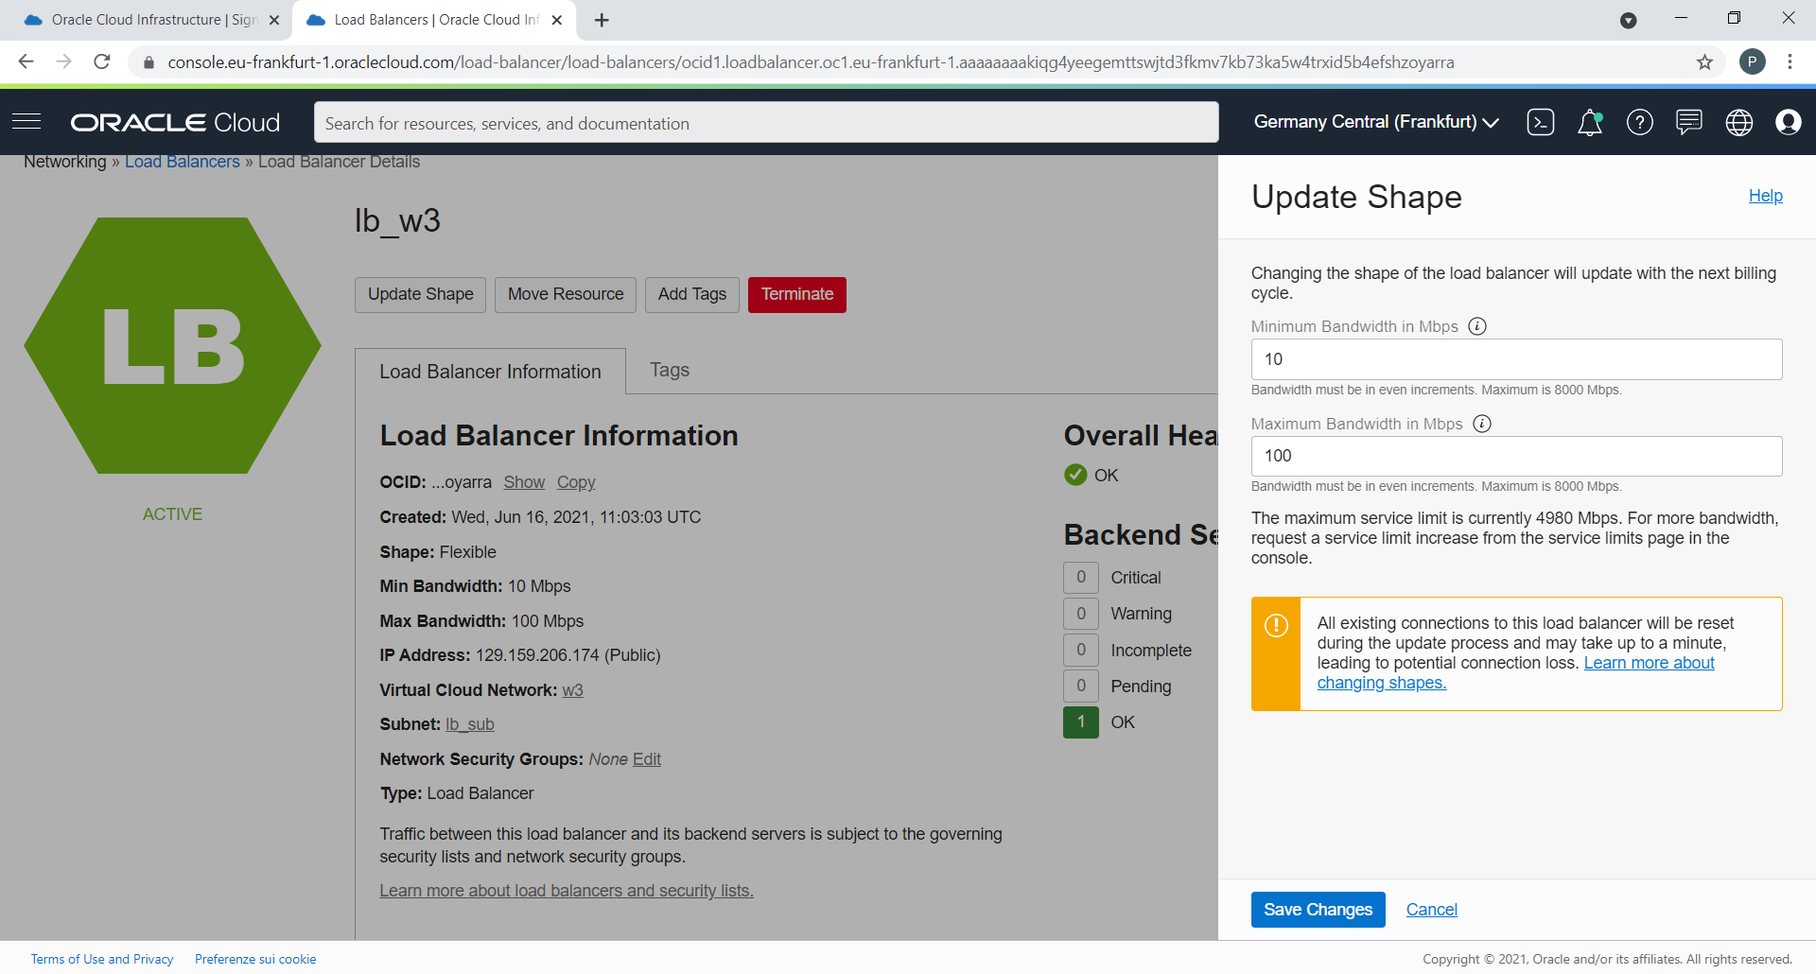
Dynamic Change of LB Shapes
OCI Standard Load Balancer
OCI launched Dynamic Change of Shapes, where customers can switch between shape options on their LB instance at runtime
Customer can switch between bandwidth shapes without having to create a new LB as a workaround
10 Mbps 100 Mbps 400 Mbps 8,000 Mbps shapes

Slide 11
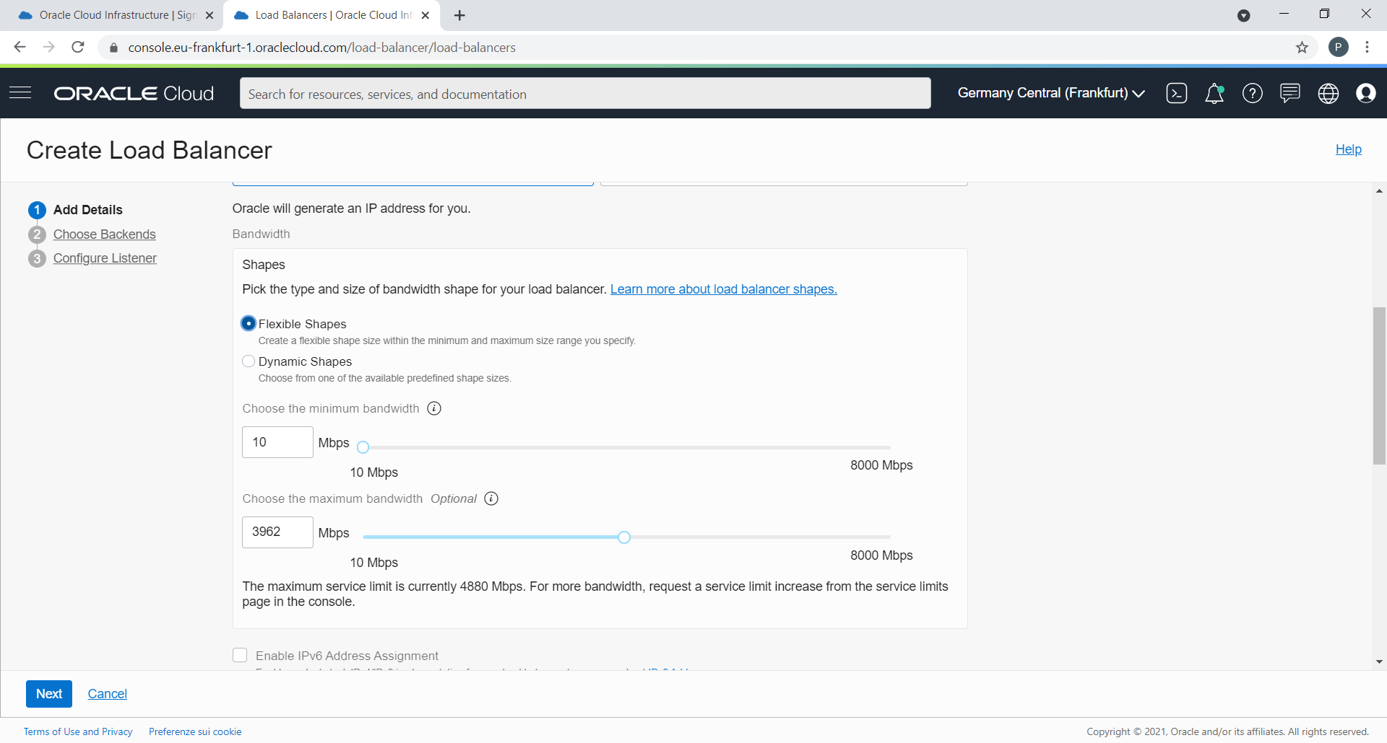
Flexible Load Balancer
OCI Standard Load Balancer
Customer just defines the minimum and maximum bandwidth
• Minimum bandwidth provides instant readiness for load
• Maximum bandwidth allows control of maximum cost
• Customer pays a minimal base cost for the load balancer and then pays a simple single rate
for the larger of the reserved bandwidth or the maximum bandwidth actually used each
minute

Slide 12
Load Balancing Policies
OCI Standard Load Balancer
Round Robin: default policy, distributes incoming traffic sequentially to each server in a backend set. After each server has received a connection, the load balancer repeats the list in the same order.
IP Hash: uses an incoming request's source IP address as a hashing key to route non-sticky traffic to the same backend server
Least Connection: routes incoming non-sticky request traffic to the backend server with the fewest active connections
Load balancer policy decisions apply differently to TCP load balancer, cookie-based session persistent HTTP requests (sticky requests), and non-sticky HTTP requests
A TCP load balancer considers policy and weight criteria
An HTTP load balancer w/ cookie-based session persistence forwards requests using cookie's session info
For non-sticky HTTP requests, the load balancer applies policy and weight criteria

Slide 13
Health Check
OCI Standard Load Balancer
Health check is a test to confirm the availability of backend servers. Health Check is activated for
Backends
Backend set
Overall Load Balancer
A load balancer IP can have up to 16 listeners (port numbers). Each listener has a backend set that can have 1 to N backend servers
Server 1
Load Balancer IP
Listener
Server 2
Backend set
Listener
Server 3
Health API provides a 4-state health status (ok, warning, critical, unknown)
Health status is updated every three minutes

Slide 14
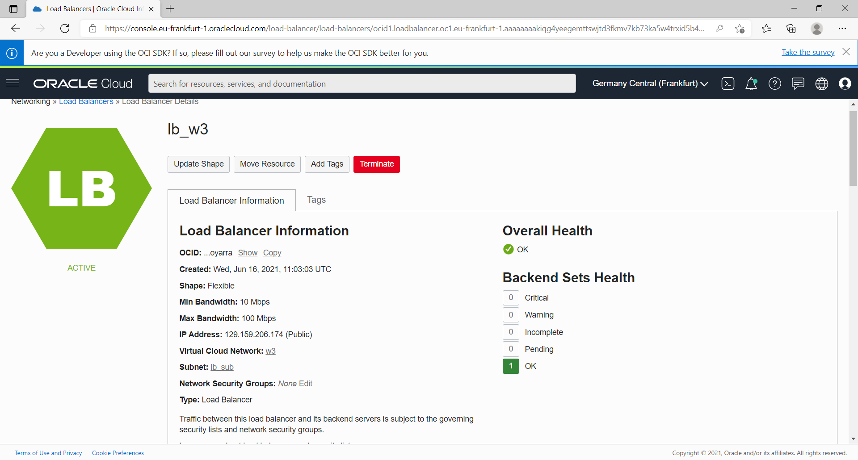
Health Check
OCI Standard Load Balancer

Slide 15
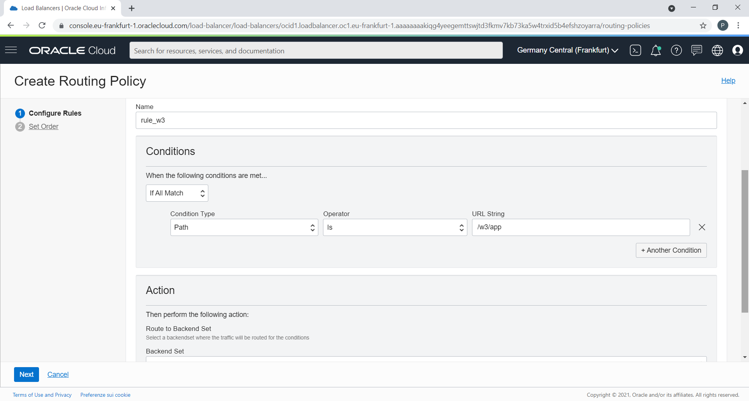
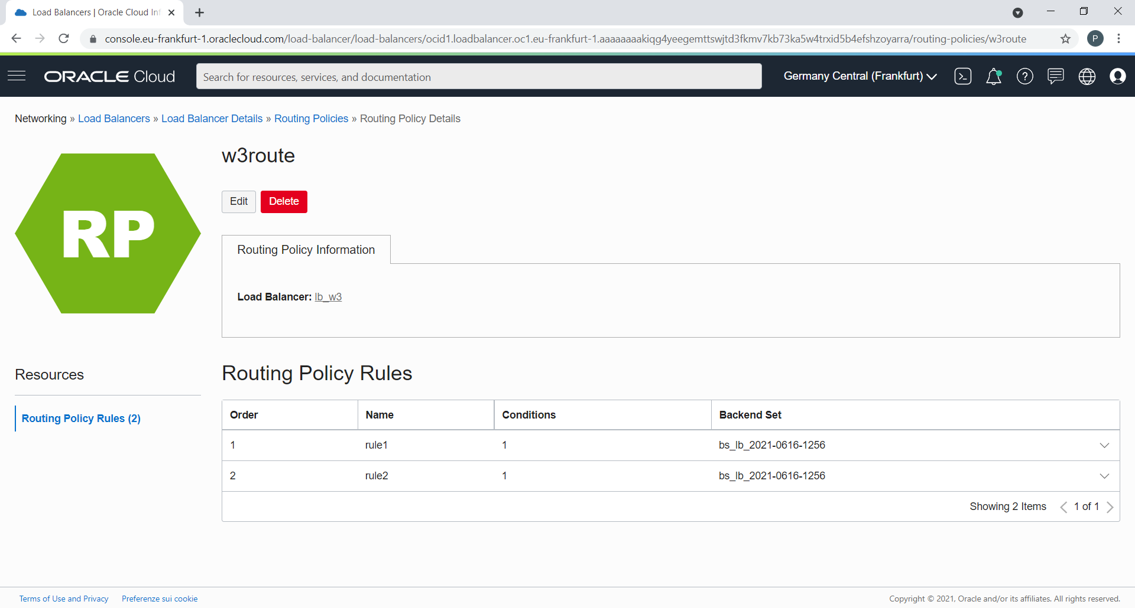
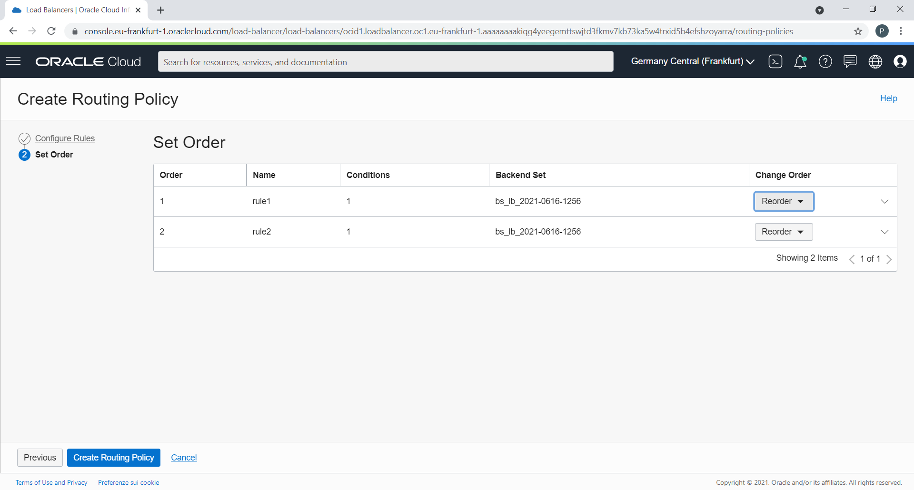
Request Routing
OCI Standard Load Balancer
Each HTTP request is evaluated against the rules.
The rules are run in the order that is defined in the policy.
Each rule has at least one condition and a backend set.
If the HTTP request condition matches a rule, the request is forwarded to the backend set defined for the rule. The other rules in the policy are skipped and the request is not evaluated against them

Slide 16
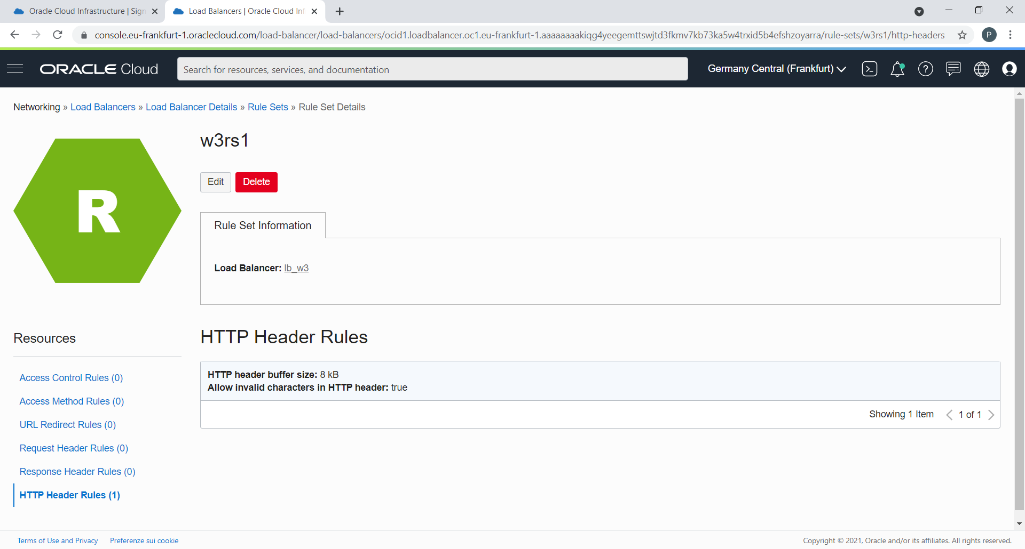
OCI Standard Load Balancer
Rule Set
A rule set is a named set of rules associated with a load balancer and applied to one or more listeners on that load balancer
Access control rules restrict access to application resources based on the source of the request.
Access method rules specify the permitted HTTP methods.
URL redirect rules route incoming HTTP requests to a different destination URL.
Request and response header rules, which add, alter, or remove HTTP request or response headers.
HTTP header rules, which specify the size of the HTTP header, enlarge header and whether period and underscore characters are permitted within the headers.

Slide 17
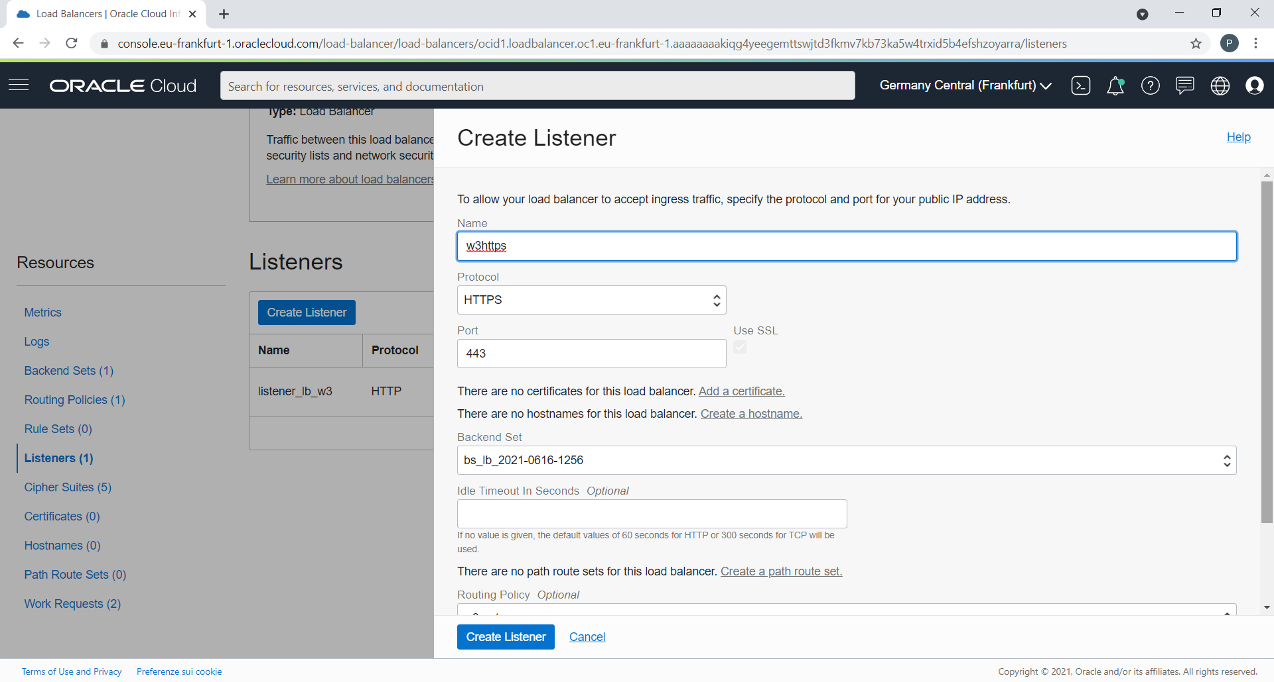
SSL Handling
OCI Standard Load Balancer
Terminate SSL at the load balancer. This configuration is frontend SSL. Your load balancer can accept encrypted traffic from a client. No encryption of traffic exists between the load balancer and the backend servers.
Implement SSL between the load balancer and your backend servers. This configuration is backend SSL. Your load balancer does not accept encrypted traffic from client servers. Traffic between the load balancer and the backend servers is encrypted.
Implement point-to-point SSL. Your load balancer can accept SSL encrypted traffic from clients and encrypts traffic to the backend servers.
To use SSL with your load balancer, you must add one or more certificate bundles to your system.
Oracle Cloud Infrastructure accepts x.509 type certificates in PEM format only.
Notes:
To use SSL with your load balancer, you must add one or more certificate bundles to your system. The certificate bundle you upload includes the public certificate, the corresponding private key, and any associated Certificate Authority (CA) certificates. For the easiest workflow, upload the certificate bundles you want to use before you create the listeners or backend sets you want to associate them with.
The Load Balancing service does not generate SSL certificates. It can only import an existing certificate that you already own. The certificate can be one issued by a vendor, such as Verisign or GoDaddy. You can also use a self-signed certificate that you generate with an open source tool, such as OpenSSL or Let's Encrypt.

Slide 18
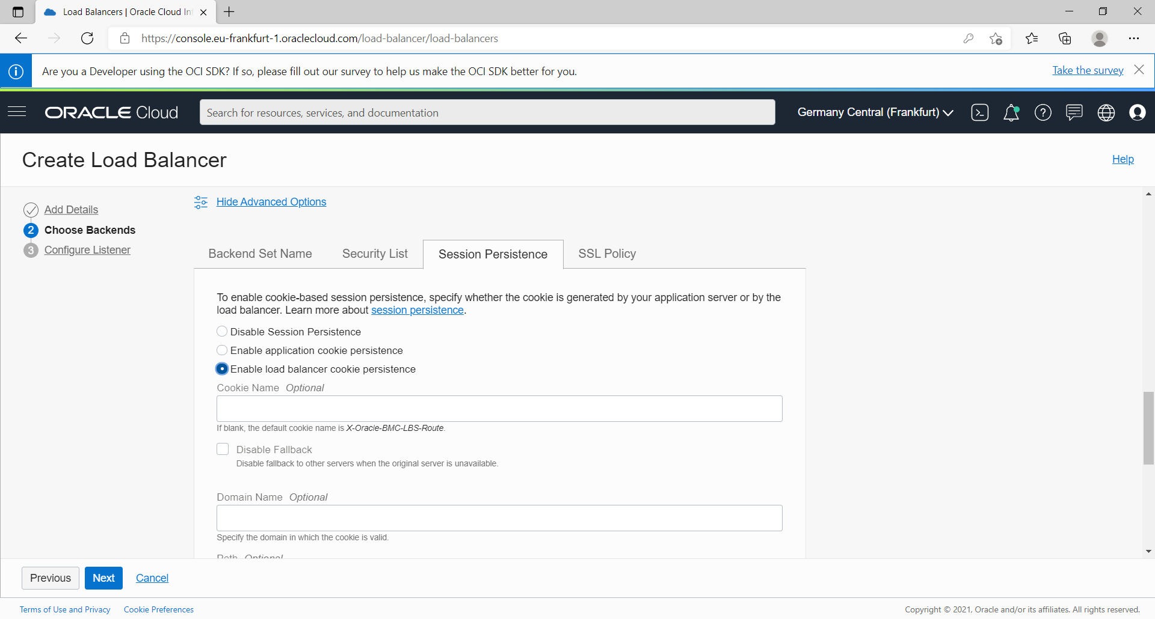
Session Persistence
OCI Standard Load Balancer
Session persistence is a feature that can be configured and enabled on the level of a backend set. For each backend set, two parameters are set to control it:
Cookie name: the name of a cookie, or a match-all pattern, that will be set in the response from the backend server to request session persistence, application or lb generated
Fallback: a boolean value that controls how OCI LB handles session persisted requests in case the original backing server isn't available false: the load balancer fails the request and returns an HTTP 502 code

Slide 19
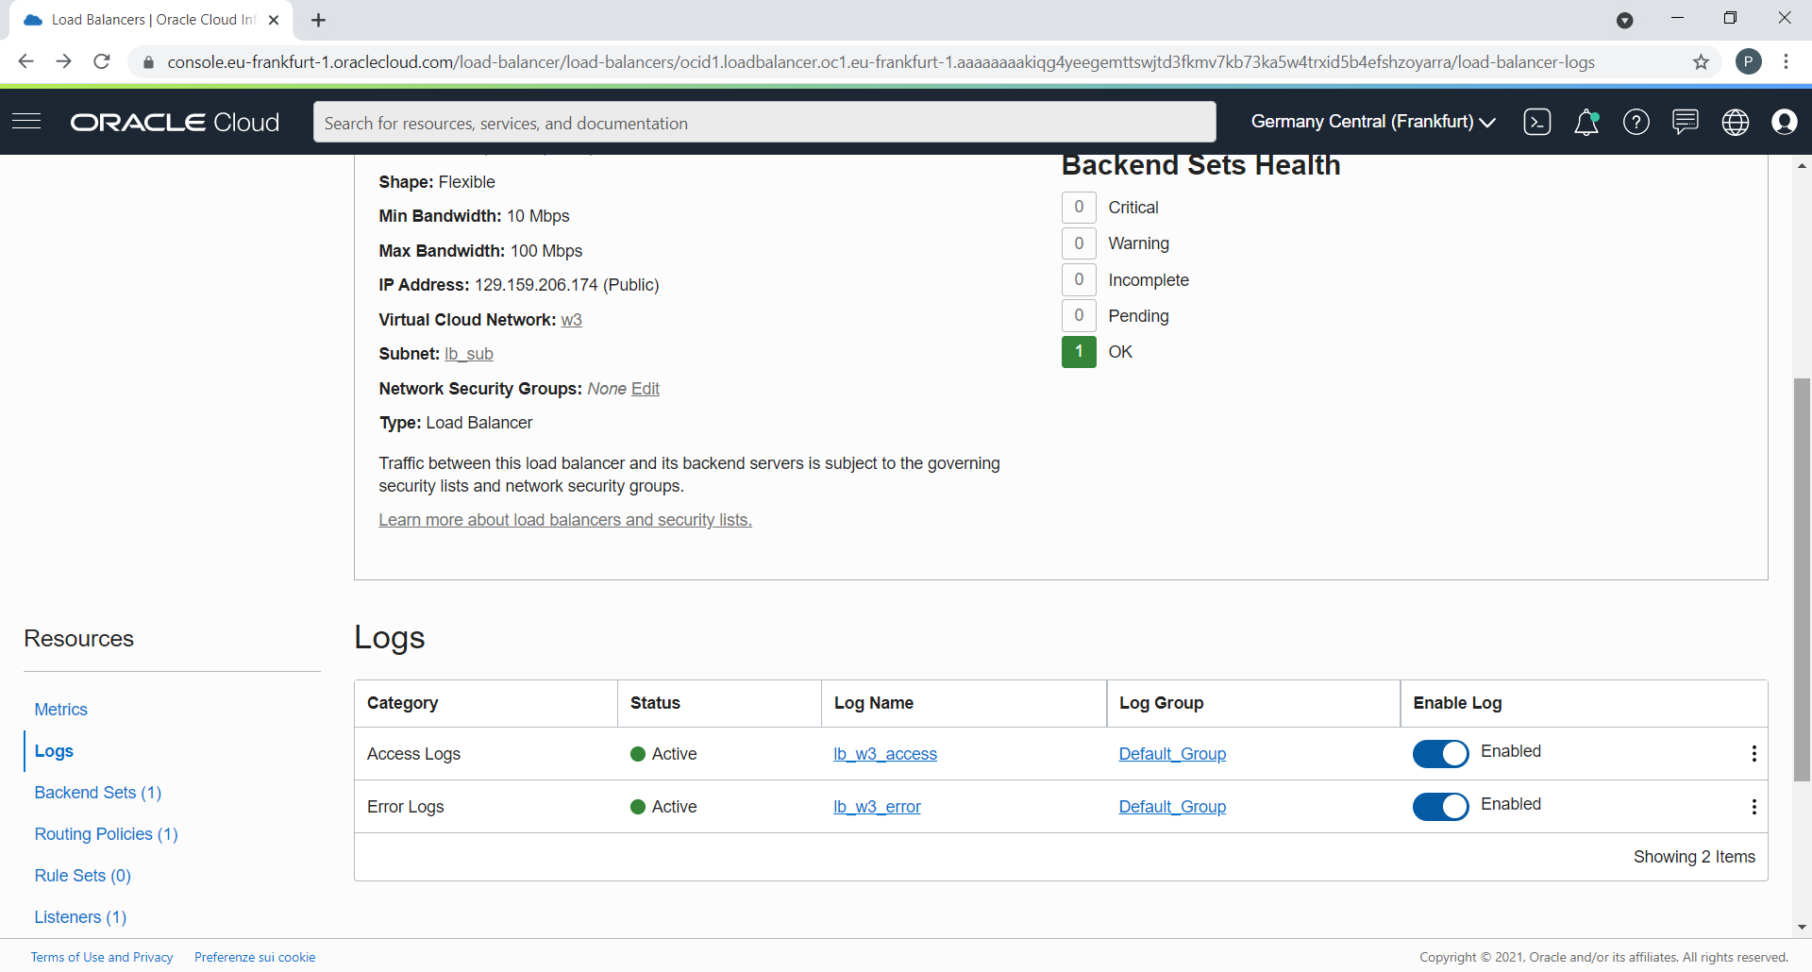
Logging
OCI Standard Load Balancer
https://docs.oracle.com/en-us/iaas/Content/Balance/Reference/troubleshooting_load_balancer.htm

Slide 20
Load Balancer Metrics - Dimensions
OCI Standard Load Balancer
AVAILABILITYDOMAIN
The availability domain in which the load balancer resides.
BACKENDSETNAME
The name of the backend set to which the metrics apply.
LBCOMPONENT
The load balancer component to which the metrics apply.
Valid metrics for the three lbComponent dimension values:
Backendset
Listener
Loadbalancer
LBHOSTID
A unique ID that represents the current load balancer host. This ID is subject to change.
LISTENERNAME
The name of the listener to which the metrics apply.
REGION
The region in which the load balancer resides.
RESOURCEID
The OCID of the resource to which the metrics apply.
Notes:
You can monitor the health, capacity, and performance of your load balancers by using metrics , alarms , and notifications.
The Load Balancing service metrics help you measure the number and type of connections, and quantity of data managed by your load balancer. You can use metrics data to diagnose and troubleshoot load balancer and client issues. The metrics also help you analyze the HTTP responses returned by the servers in your backend set.

Slide 21
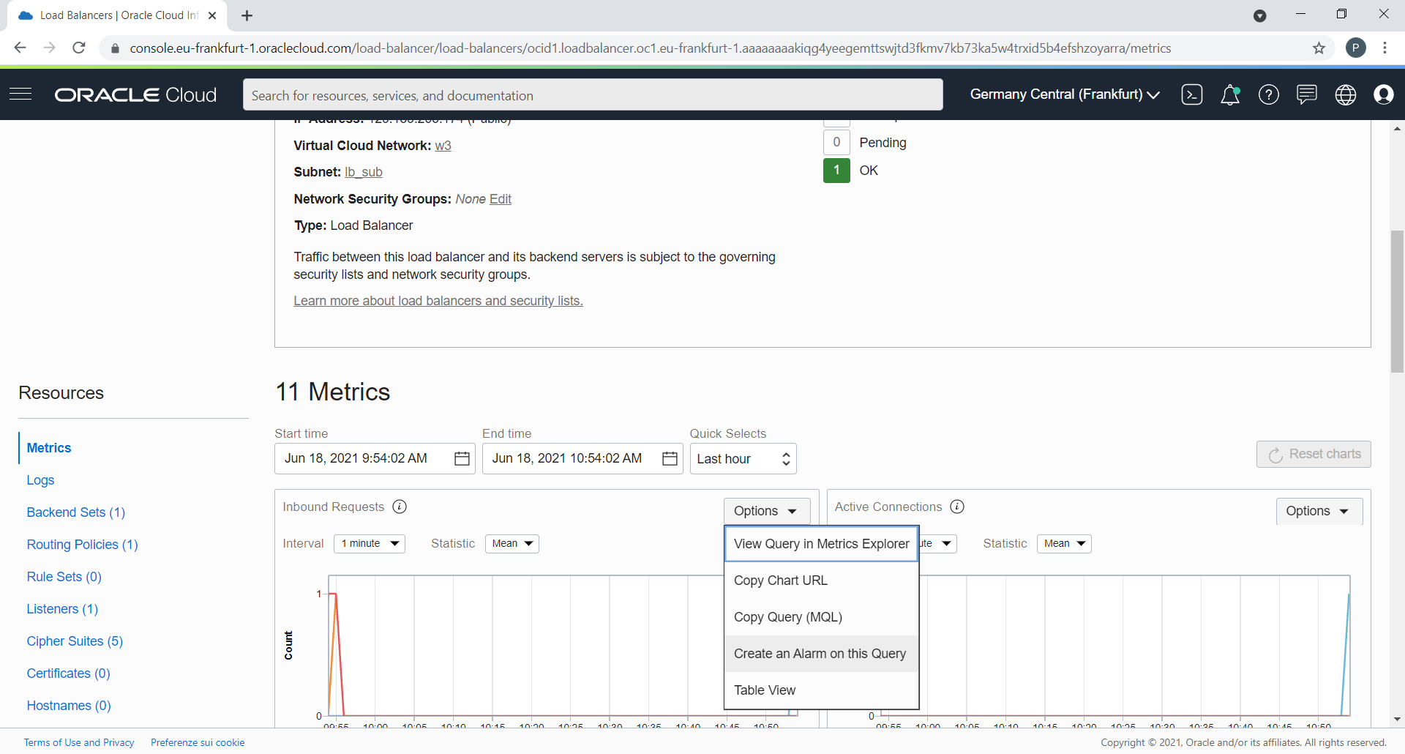
General Metrics for LB
OCI Standard Load Balancer

Slide 22
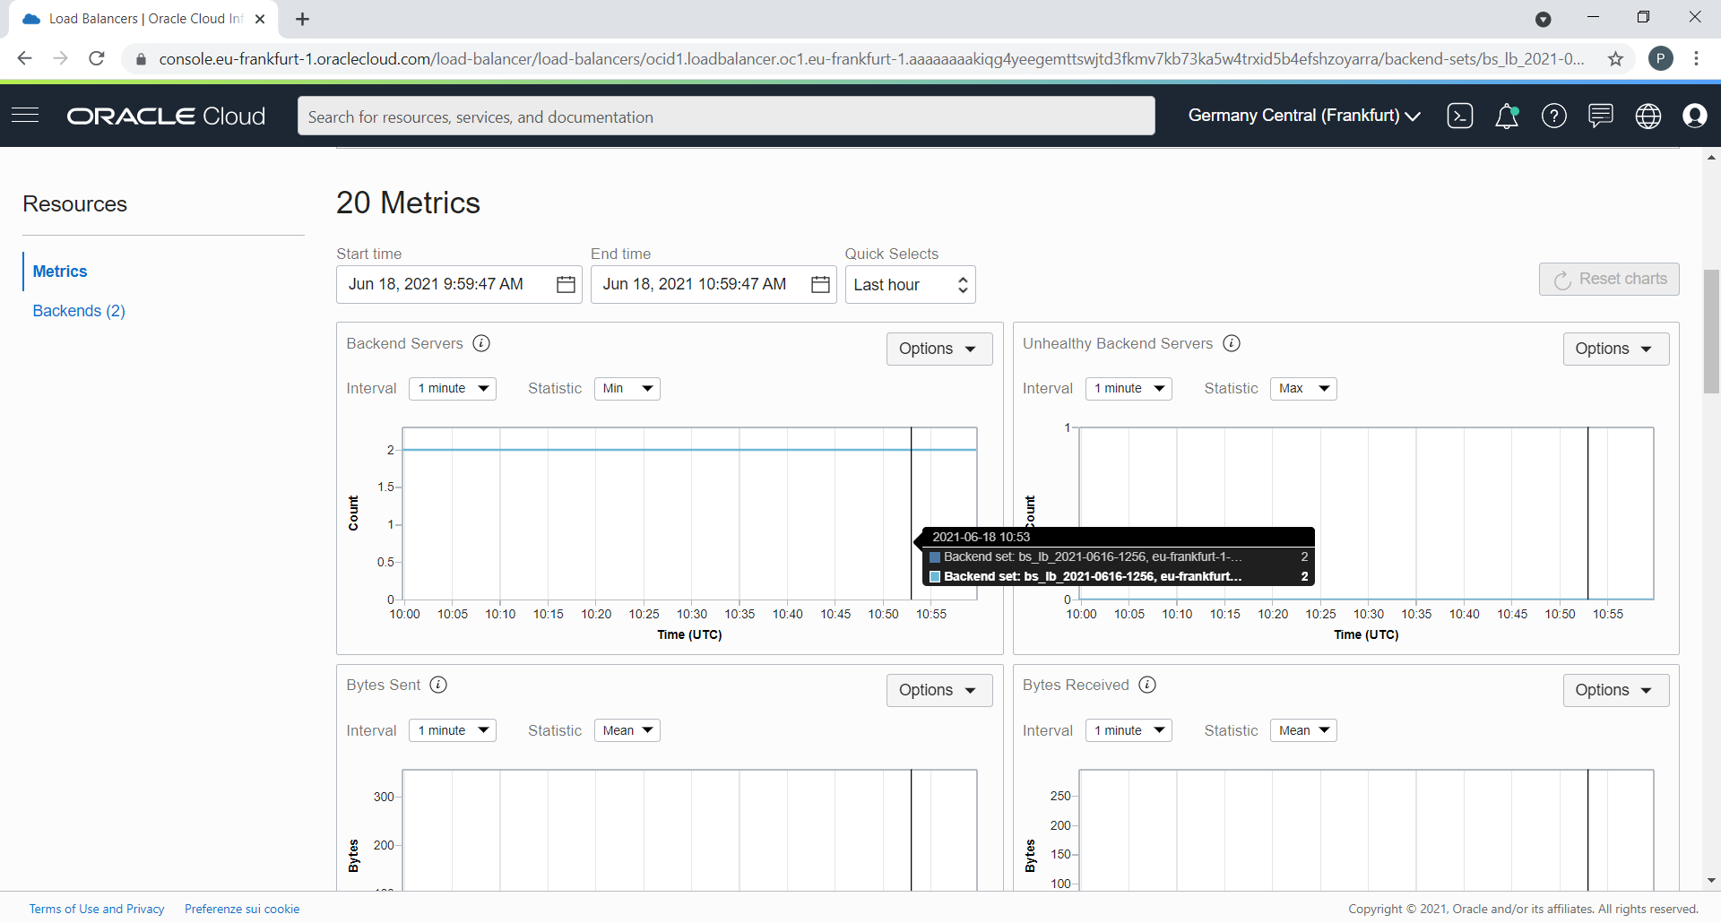
Metrics for Backend Set
OCI Standard Load Balancer

Slide 23
Network Load Balancer
OCI Network Load Balancer
The Network Load Balancer load balance layer 3 and layer 4 (TCP/UDP/ICMP) workloads
It’s designed to handle volatile traffic patterns and millions of flows, offering high throughput while maintaining ultra-low latency.
Ideal load balancing solution for latency-sensitive workloads includes real-time streaming, VoIP, Internet of Things, and trading platforms
The Network Load Balancer is optimized for long-running connections in the order of days or months, which makes it best suited for your database or WebSocket type applications
The Network Load Balancer operates at the connection level and balances incoming client connections to healthy backend with session affinity for udp/tcp a given flow is always forwarded to the same backend for the lifetime of the connection
OCI Flexible Network Load Balancer can be public or private
Provides the benefits of flow high availability, source and destination IP addresses, and port preservation

Slide 24
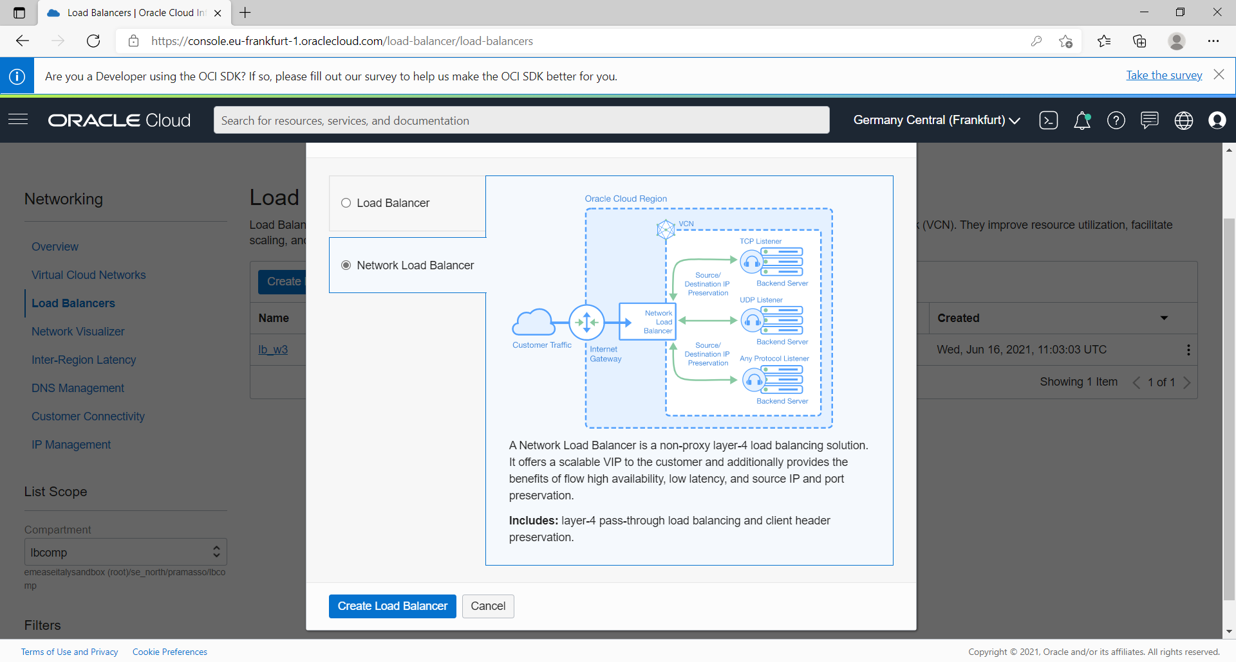
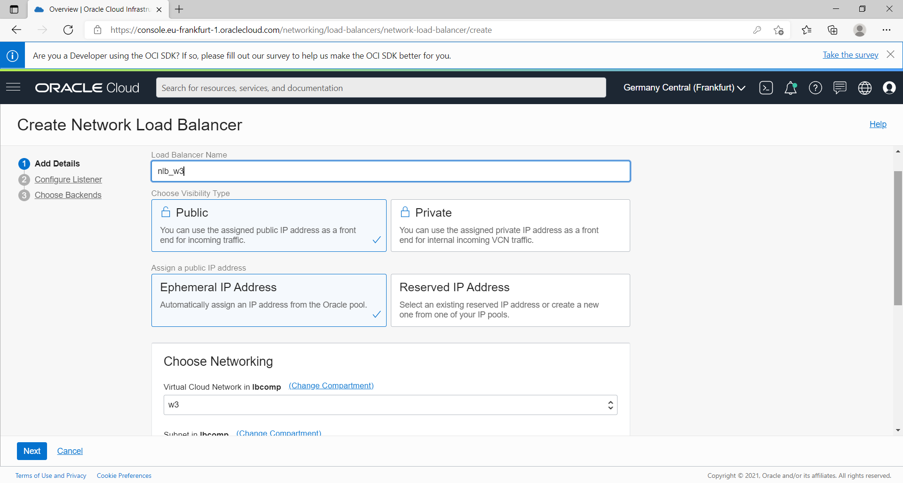
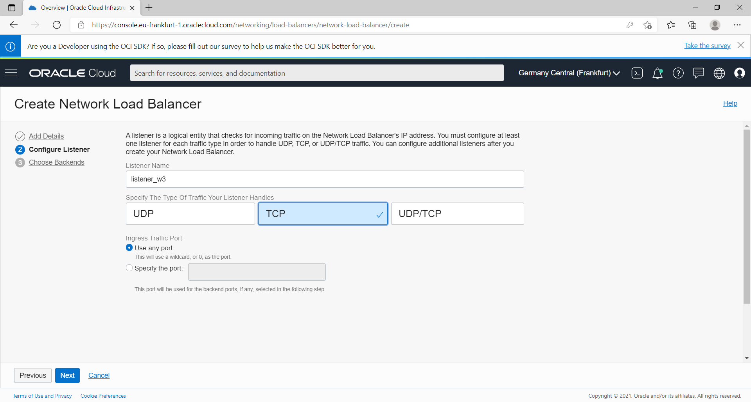
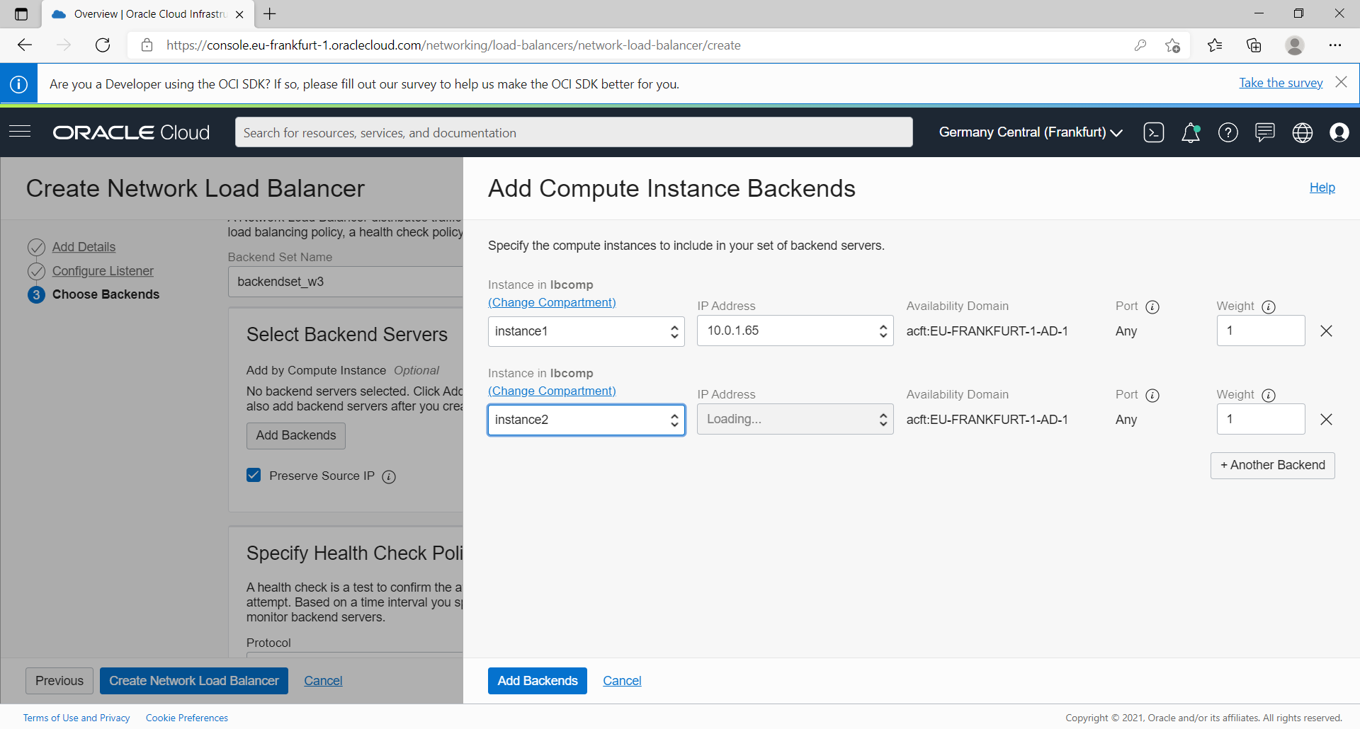
Network Load Balancer Creation Steps
OCI Network Load Balancer
nlb
Listener
Port def.
backends

Slide 25
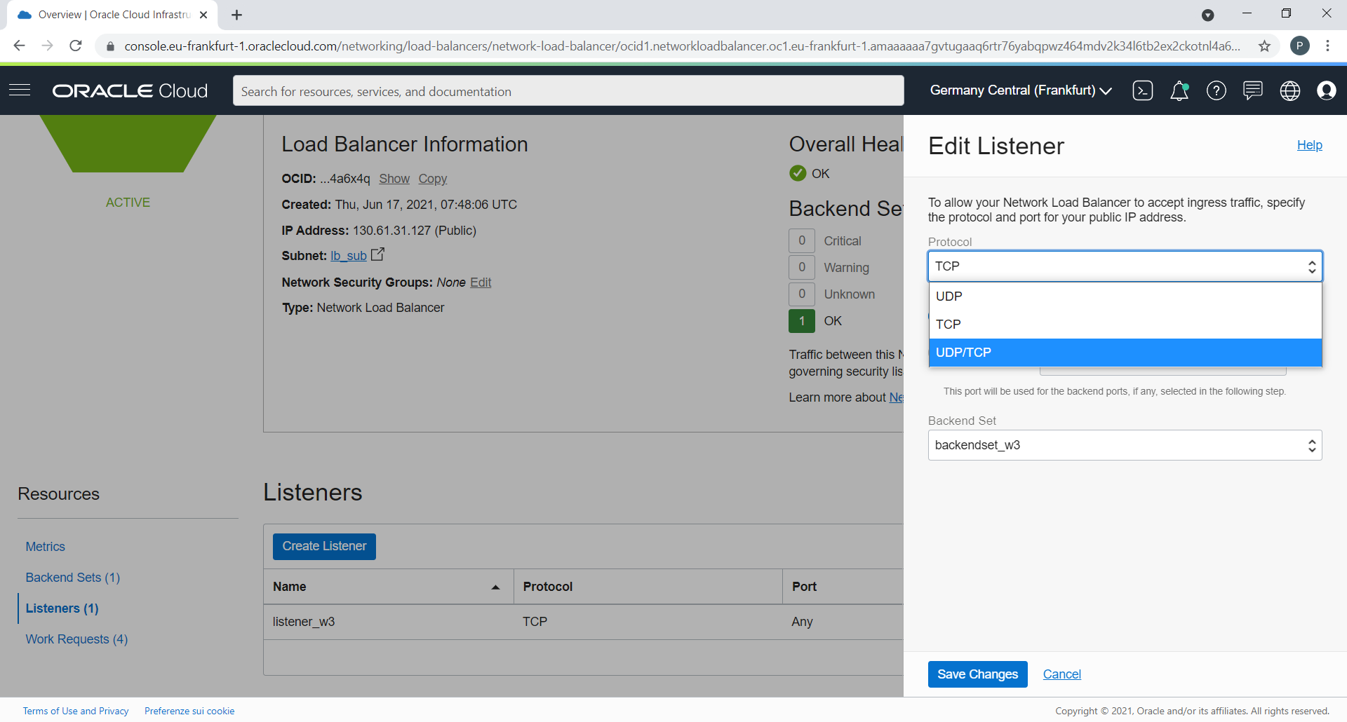
Network Load Balancer (cont.)
OCI Network Load Balancer
Protocol: Required. Select one of the following options:
UDP
TCP
UDP/TCP

Slide 26
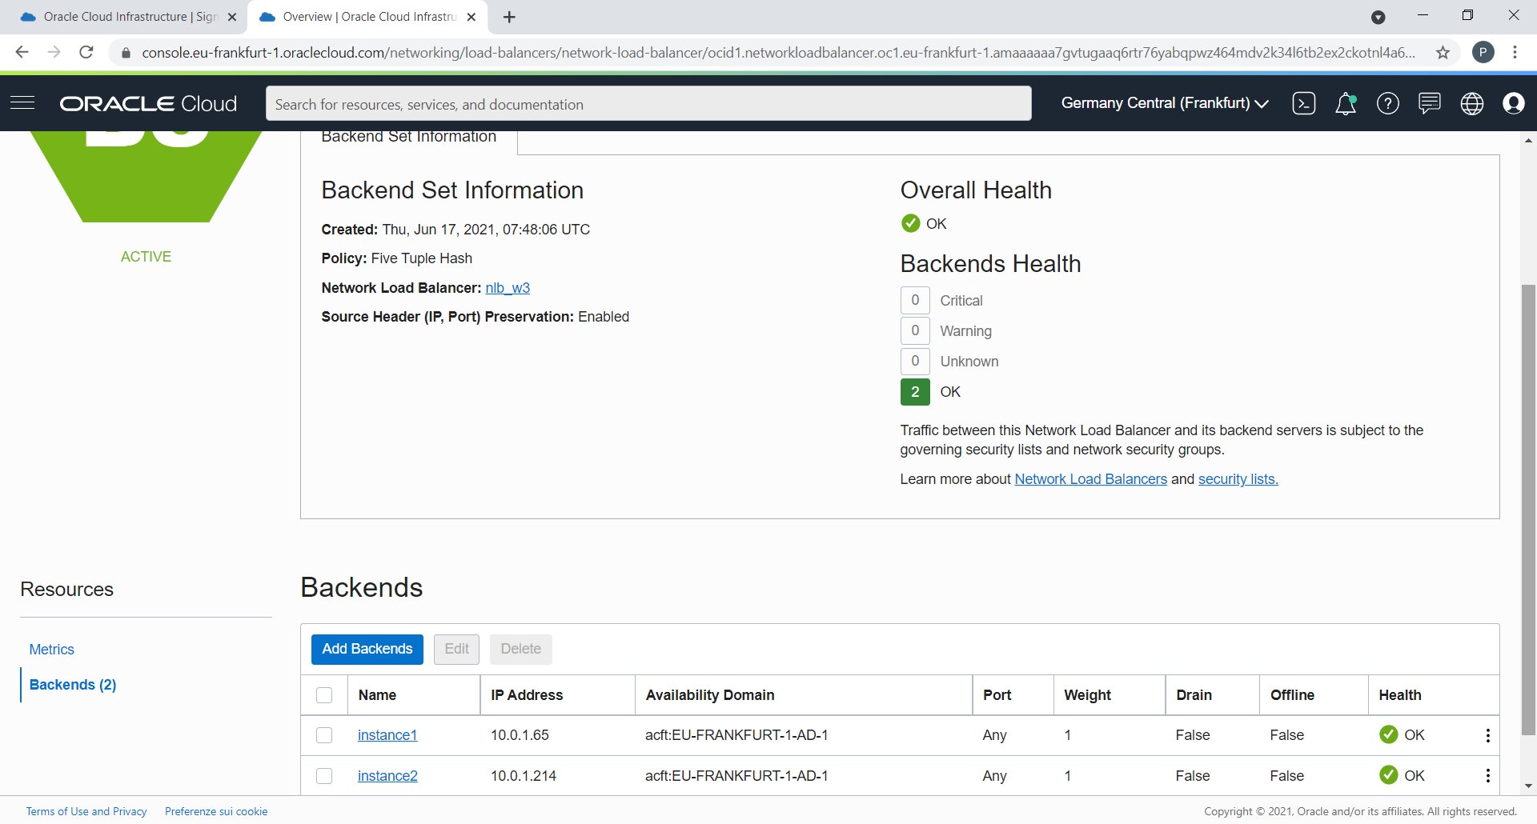
Network Load Balancer (cont.)
OCI Network Load Balancer
5-Tuple Hash: Routs incoming traffic based on 5-Tuple (source IP and port, destination IP and port, protocol) Hash. This is the default network load balancer policy.
3-Tuple Hash: Routs incoming traffic based on 3-Tuple (source IP, destination IP, protocol) Hash.
2-Tuple Hash: Routs incoming traffic based on 2-Tuple (source IP Destination, destination IP) Hash.
The 5-Tuple Hash policy provides session affinity within a given TCP or UDP session, where packets in the same session are directed to the same backend server behind the flexible network load balancer. Use a 3-Tuple or 2-Tuple network load balancing policy to provide session affinity beyond the lifetime of a given session

Slide 27
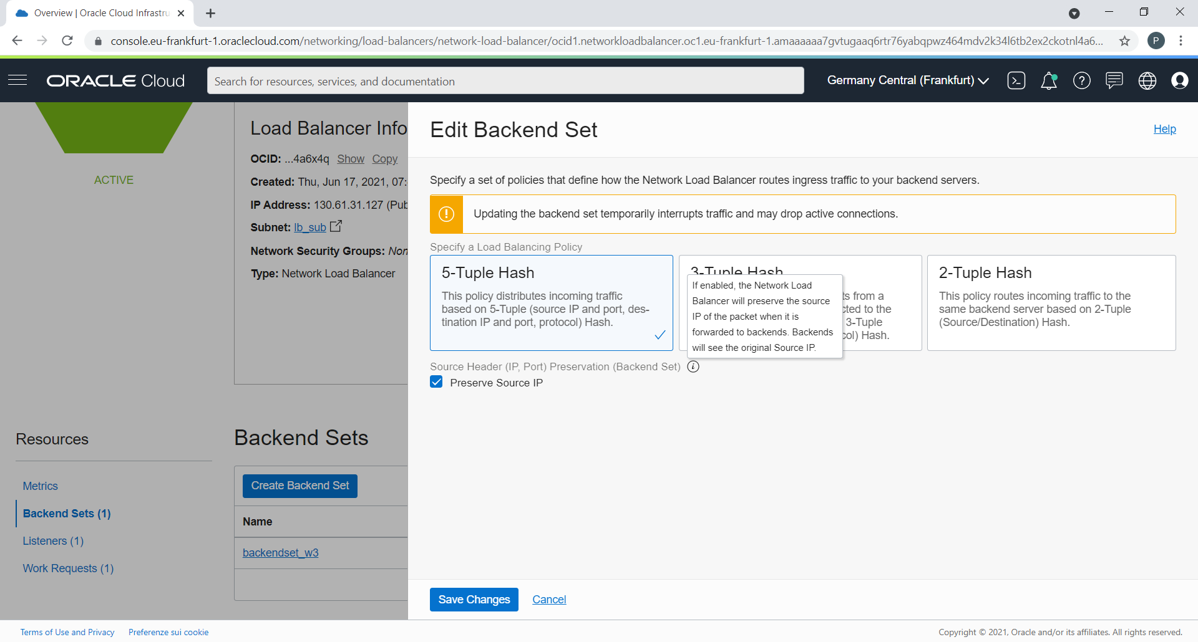
Network Load Balancer (cont.)
OCI Network Load Balancer
Check Preserve Source IP to preserve the original source and destination header (IP addresses and ports) of each incoming packet all the way to the backend server

Slide 28
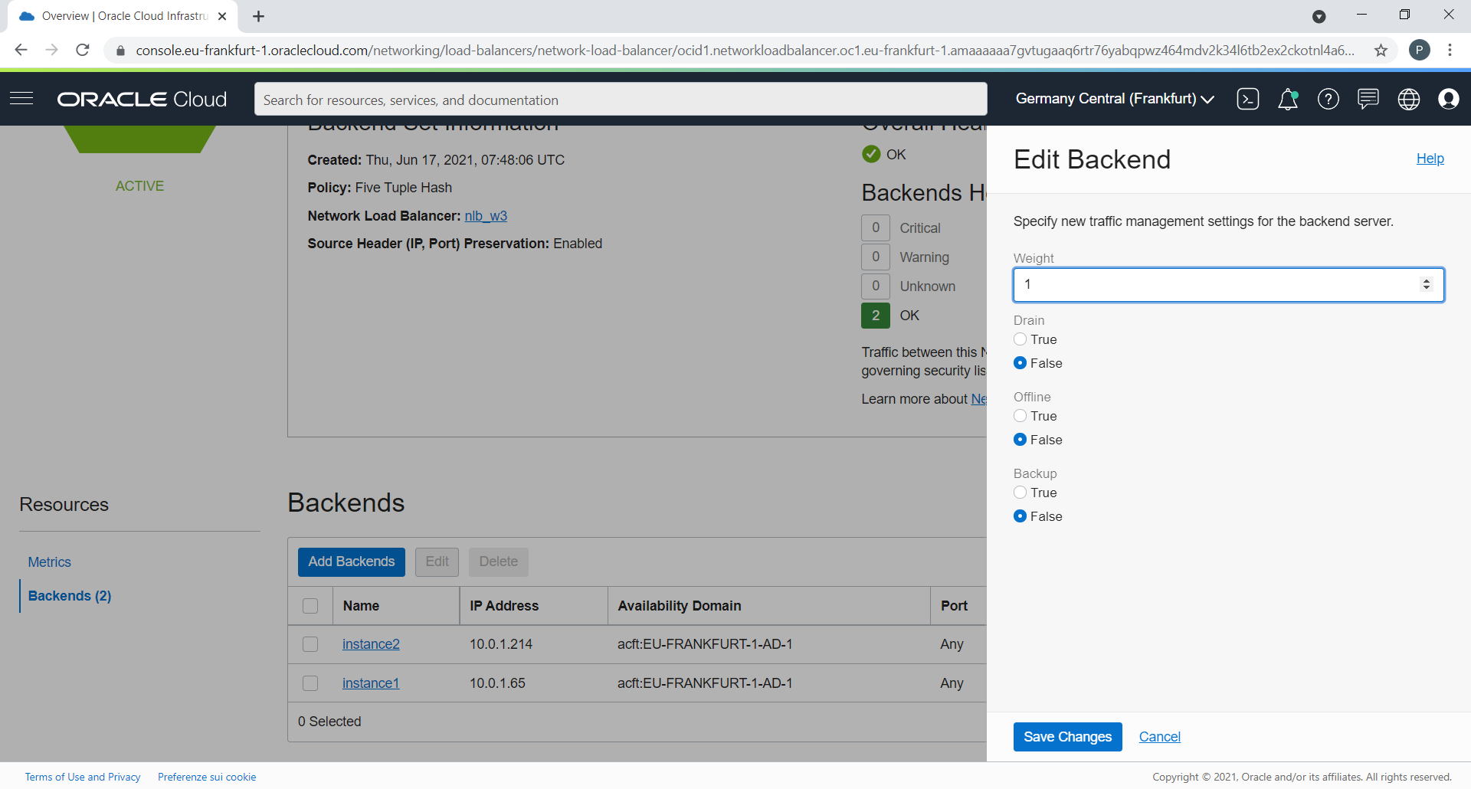
Network Load Balancer (cont.)
OCI Network Load Balancer
Weighting affects the proportion of requests directed to each server. For example, a server weighted as 3 receives three times the number of connections as a server weighted as 1

Slide 29
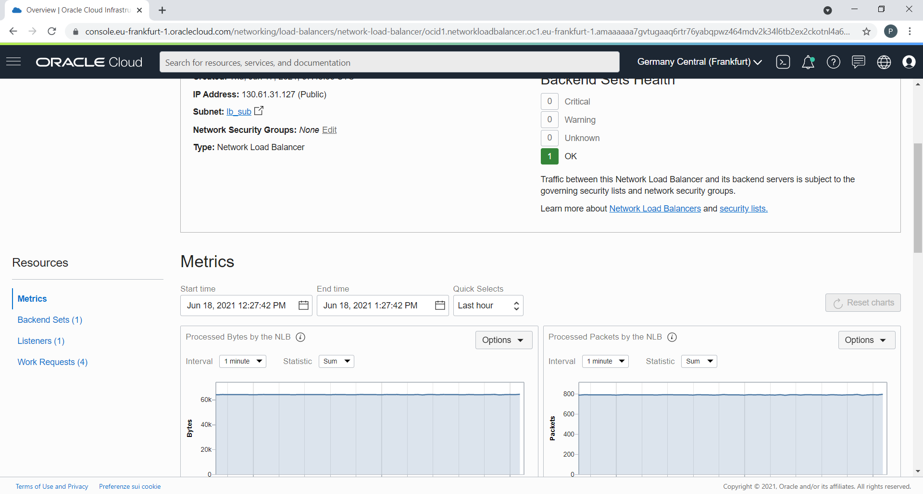
Network Load Balancer (cont.)
OCI Network Load Balancer
https://docs.oracle.com/en-us/iaas/Content/NetworkLoadBalancer/WorkRequests/metrics.htm
https://docs.oracle.com/en-us/iaas/Content/Network/Concepts/vcn_flow_logs.htm#vcn_flow_logs

Slide 30
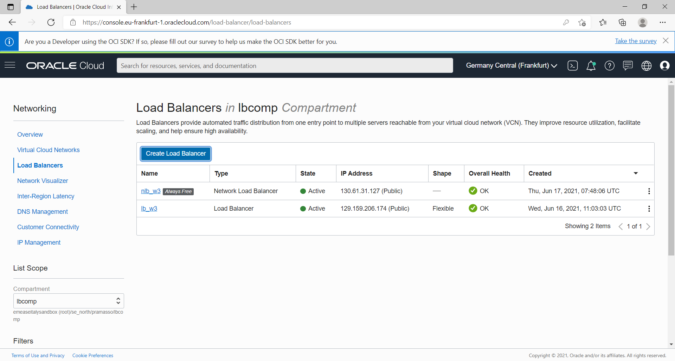
Both LB and NLB Summary
Oracle Cloud Infrastructure Load Balancing service provides automated traffic distribution from one entry point to multiple servers reachable from your virtual cloud network (VCN) to load balance transport Layer 4 and Layer 7 (TCP and HTTP) traffic
Oracle Cloud Infrastructure Flexible Network Load Balancing service (Network Load Balancer) provides automated traffic distribution from one entry point to multiple backend servers in your virtual cloud network (VCN). It operates at the connection level and load balances incoming client connections to healthy backend servers based on Layer 3/Layer 4 (IP protocol) data.

Slide 31
Q/A

Slide 32
Thank you

